Slide 1
Tarik Reza Toha¹, Masfiqur Rahaman², Saiful Islam Salim³, Mainul Hossain⁴, Arif Mohaimin Sadri⁵, and A. B. M. Alim Al Islam⁶
Notes:
Assalamualaikum, hello everyone. I am Tarik Reza Toha from Bangladesh University of Engineering and Technology. Today I am going to present my paper titled “DhakaNet: Unstructured Vehicle Detection using Limited Computational Resources”. Rest of the authors are Masfiqur Rahaman, Saiful Islam Salim, Mainul Hossain, Arif Mohaimin Sadri, and A. B. M. Alim Al Islam. The fifth author is from University of Oklahoma and other authors are from Bangladesh University of Engineering and Technology. This research has been conducted under a fellowship from the ICT Division of Bangladesh. Before we start, let’s see the outline of my presentation.

Slide 2
Overview of This Presentation
Background and motivation
Our proposed approach
Experimental results and findings
Conclusion and future work
Notes:
At first, we will talk about the background and motivation. Next, we will discuss the proposed approach. After that, we will show the experimental results and findings. Finally, we will conclude our presentation with some future work. Let’s start with the background of our study.

Slide 3
Traffic Congestion in Dhaka
Average public transport speed is 7 kph
Expected to be only 4 kph (slower than walking speed) by 2035
Wastes ~3.2 million working hours daily
An annual loss of billions of dollars
[Source: World Bank Report (2018)]
1. https://openknowledge.worldbank.org/handle/10986/29925
2. https://www.thedailystar.net/frontpage/colossal-loss-1553002
Notes:
Traffic congestion is one of the most serious challenges for the cities of developing countries such as Bangladesh, India, Kenya, etc. According to the World Bank Report, particularly in Dhaka (capital of Bangladesh), the average driving speed is 7 kilometers per hour (kph), which is expected to be only 4 kph (slower than walking speed) by 2035. Moreover, traffic congestion in Dhaka wastes about 3.2 million working hours daily and billions of dollars of the national economy annually. Therefore, it is extremely important to develop some solutions to fix this problem. Accordingly, there exist some solutions in the literature. Now, we will see some of the solutions.

Slide 4
Existing Solution for Limiting Traffic Jam
Capture on-road traffic images
Send images to server
Estimate traffic density and optimize signal timing
This centralized solution demands high-speed network connectivity, which is not always available across all road intersections in the developing countries such as Bangladesh, India, Kenya, etc. (Chauhan et al., 2019)
Adaptive traffic control system (Lee et al., 2020)
Notes:
For example, Lee et al., proposed an adaptive traffic control system. In this approach, we need to capture on-road traffic images and upload them to the cloud for necessary processing tasks such as vehicle detection. However, these cloud-based solutions demand high-speed network connectivity, which is not always available across all road intersections in developing countries. Hence, we need to decentralize our approach.

Slide 5
An Alternative Existing Solution for Limiting Traffic Jam
Capture traffic images and estimate traffic density
Send only the vehicle count to server
Optimize signal timing
Embedded systems are needed to be deployed at signalized intersections to estimate traffic density in real-time
It imposes severe computational constraints on DL architectures to estimate traffic density on-road
Decentralized adaptive traffic control system
(Yeshwanth et al., 2017)
Notes:
In a decentralized approach, vehicle detection is performed in the embedded platforms and only the vehicle count is uploaded to the cloud. The fundamental difference between this approach and the previous work is that, here, we need to estimate the traffic density on road, which was performed in the central server in the earlier study. This approach alleviates the demand for a high-speed network, however, imposes severe computational constraints (inherited from the embedded platforms) on the learning models. Therefore, we need to work on the deep learning architecture itself to make sorts of solution viable to practice. Accordingly, there exists some studies in the literature that deal with the DL architecture itself to make that viable for this sort of solution. Let me show some of the solutions.

Slide 6
Existing Deep Learning Architectures
EfficientDet: Scalable and Efficient Object Detection
Tan et al., CVPR, IEEE, 2020
Scaled-YOLOv4: Scaling Cross Stage Partial Network
Wang et al., CVPR, IEEE, 2021
YOLOv5: Leading Edge Artificial Intelligence Solutions
Jocher et al., Ultralytics Company, 2020
These architectures neither attain faster inference speed nor higher accuracy because of their inherent limitations
Notes:
Tan et al., proposed a scalabale and efficient object detection model named EfficientDet. Besides, Wang et al., proposed scaled-yolov4 through scaling the cross-stage partial network. Next, Jocher et al., from Ultralytics company, proposed YOLOv5 for real-time object detection. The common drawback of these solutions is that they neither attain faster inference speed nor higher accuracy because of their inherent limitations. To overcome the limitations, we have proposed DhakaNet in our paper.

Slide 7
Our Contribution
We propose a novel low-resource DL architecture (DhakaNet) for faster and more accurate vehicle detection in street-view traffic images captured by on-road cameras
Notes:
We propose a novel low-resource deep learning architecture named DhakaNet for faster and more accurate vehicle detection in street-view traffic images, which have been captured from on-road cameras. Next, we will see our proposed methodology.

Slide 8
mCSP: Our Proposed Backbone Network
At the beginning layers
At the later (deeper) layers
Increases the accuracy
Increases the inference speed
Modified Cross-Stage Partial Networks
Notes:
In our backbone network, we propose a modified CSP module using higher number of filters and limiting the number of bottlenecks. In the left module, we use one bottleneck and in the right one, we use no bottleneck. The increased filters increase the accuracy and the limited bottleneck increase the inference speed. Next, we will see some existing neck networks along with their limitations.

Slide 9
mPANet: Our Proposed Neck Network
Increases the accuracy using a small overhead
Exactly ONE extra connection is possible
Modified Path Aggregation Network
Notes:
In our neck network, we propose a modified PANet that adds an extra edge from input to output nodes if they are at the same level. It fuses more features without adding much computational cost. Next, we will propose a novel plugin module to increase the accuracy of our low-resource architecture.

Slide 10
MSAM: Our Proposed Plugin Module
Fuses local features within the same layer
Identifies meaningful features
Localizes meaningful features
Multi-Scale Attention Module
Notes:
In a limited-resource network, it is very difficult to learn semantically rich features from the images. Hence, we develop a novel multi-scale attention module to extract multi-scale and meaningful features from the images. This module has three blocks namely spatial pyramid pooling, channel attention, and spatial attention. The spp block fuses local features within the same convolutional layer. The cam block identifies meaningful features and sam block localizes these features from the input images. Using these three blocks, the accuracy gets increased significantly. Till now, we have presented all the improvements made in our architecture in isolation. The impact of each improvement has been studied in our analysis and presented in the ablation studies later. Now, we will show the combined architecture.

Slide 11
DhakaNet: Our Proposed Architecture
Modified CSP module
Multi-Scale Attention module
Scaling Factor = 0.29
Notes:
In the backbone, we have used modified CSP modules. In the neck, we have used modified path aggregation network. Besides, we have integrated three multi-scale attention modules prior to the detection layers. The rest of the layers are similar to yolov5-small.

Slide 12
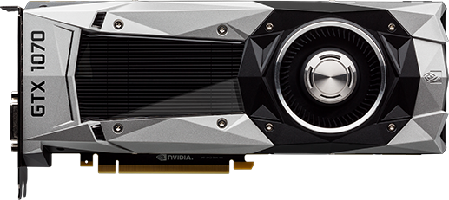
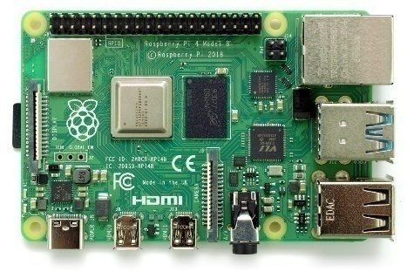
Experimental Setup
Ground truth
Box label
Data augmentation during training
HSV, translation, mosaic, and horizontal flip
Training configuration
Input size: 768 × 768 × 3
Training : Validation = 0.75 : 0.25
Other configurations follow Jocher et al., 2020
GeForce GTX 1070
8 GB Memory
Training purpose only
Raspberry Pi 4 Model B
ARMv7 Processor, 4 GB RAM
Testing purpose only
Notes:
We use a straightforward way to train the DhakaNet architecture. We prepare the ground truth using conventional box labels. In the data augmentation, we change hue-saturation-brightness values of the images. Besides, we use translation, horizontal flip, and mosaic operations. Moreover, we use 768x768 image size, 25% validation split, and SGD optimizer. During object detection, we need to optimize three loss function such as bounding box regression, objectness, and classification. We use complete intersection over union for regression and binary cross-entropy for objectness and classification. Next, we see how these loss functions are used during the training stage.

Slide 13
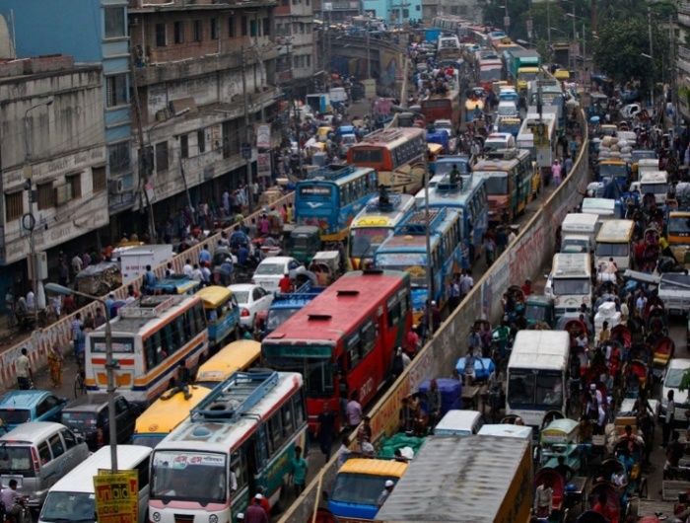
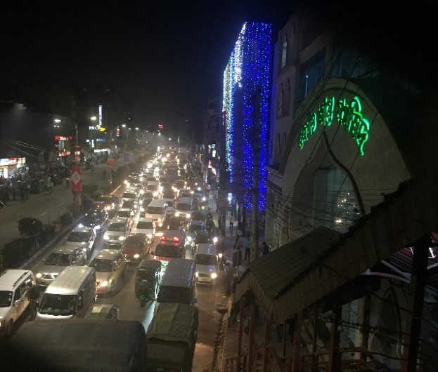
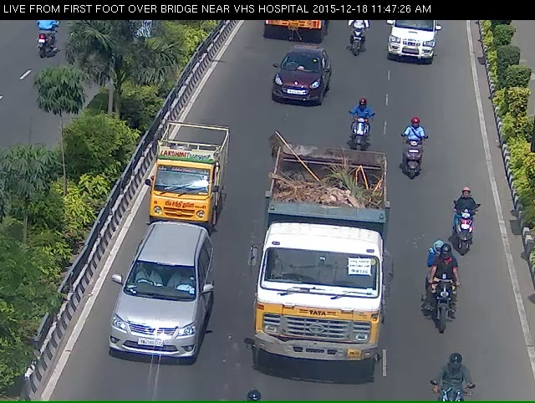
Datasets Used for Performance Evaluation
DhakaAI dataset
(Shihavuddin et al., 2020)
IITM-HeTra datasets (A and B)
(Mittal et al., 2018)
Attribute | DhakaAI | IITM-HeTra-A | IITM-HeTra-B
Traffic | Unstructured | Unstructured | Unstructured
Location | Dhaka, BD | Chennai, India | Chennai, India
Training : Testing | 3000 : 500 | 1201 : 216 | 1201 : 216
# of object classes | 21 | 3 | 4
Notes:
We use three unstructured traffic datasets in our performance evaluation. First one is DhakaAI that consists of unstructured traffic images of Dhaka city. It has 3k training and 500 test images and 21 classes of vehicles. Second one is IITM-HeTra-A that contains unstructured traffic images of Chennai city. It has 1201 training and 216 test images and 2 classes. Last one is IITM-HeTra-B that contains same images as IITM-HeTra-A. However, it has 4 classes of vehicles. Next, we see the performance evaluation metrics.

Slide 14
Evaluation Results on DhakaAI Dataset
DhakaNet achieves 50% faster inference speed, or 13% higher accuracy compared to the existing architecture
Not applicable
Notes:
Here, the data points on the right side implies faster detection, i.e., they require less computational resources, and the points on the top side implies more accurate detection. The red points are state-of-the-art models such as yolov4-tiny and yolov5-small. The green boxes are DhakaNet models, i.e., left one is original DhakaNet and the right one is down-scaled version of DhakaNet. Here, we can see that YOLOv4-tiny delivers very poor inference speed, hence, it is not a realistic solution for a decentralized adaptive traffic control system. Compared to yolov5-small, DhakaNet delivers 50% faster inference speed, or 13% better accuracy. Next, we will see the evaluation results on IITM-HeTra datasets.

Slide 15
Evaluation Results on IITM-HeTra Datasets
Not applicable
Not applicable
DhakaNet achieves 51% faster inference speed and similar accuracy on both IITM-HeTra datasets compared to the existing architecture
IITM-HeTra-A dataset
IITM-HeTra-B dataset
Notes:
In IITM-HeTra datasets, we can see that yolov5-tiny can be excluded due to having poor inference speed as before. Compared to yolov5-small, DhakaNet delivers 51% faster inference speed and comparable accuracy on both datasets. Next, we will see the ablation studies.

Slide 16
Final Output of DhakaNet
Notes:
Here are the output of yolov5-small and DhakaNet over four challenging test images of the DhakaAI dataset. We can see that, for severe occlusion, DhakaNet performs much better than YOLOv5-small. Besides, in the night scene, yolov5-small misses all vehicles whereas DhakaNet detects several ones. Next, we will see an extension of our proposed approach.

Slide 17
Conclusion and Future Work
Existing low-resource DL architectures neither attain faster inference speed nor higher accuracy due to not overcoming their inherent limitations
We propose a new architecture for embedded systems named DhakaNet
Delivers up to 51% faster or 13% more accurate detection over street-view traffic images
We plan to develop a traffic signal optimization module for a coordinated and adaptive traffic signal system for Dhaka and similar cities in future
Notes:
To conclude, existing limited-resource deep learning architectures exhibit either low inference speed, or low detection accuracy due to inherent limitations. As a remedy, we propose two novel architectures namely DhakaNet and DhakaNet-drone for better real-time vehicle detection in embedded system. Rigorous performance evaluation of DhakaNet shows up to 51% faster, or 13% more accurate detection in embedded systems. Besides, DhakaNet-drone achieves up to 50% faster, or 17% more accurate detection performance in embedded system. In future, we plan to devise an optimization module and implement a coordinated and adaptive traffic signal system in Dhaka city. Thank you.

Slide 18
Thank You
Questions are welcome!
Email: toha@tmdm.butex.edu.bd

Slide 19
Backup Slides

Slide 20
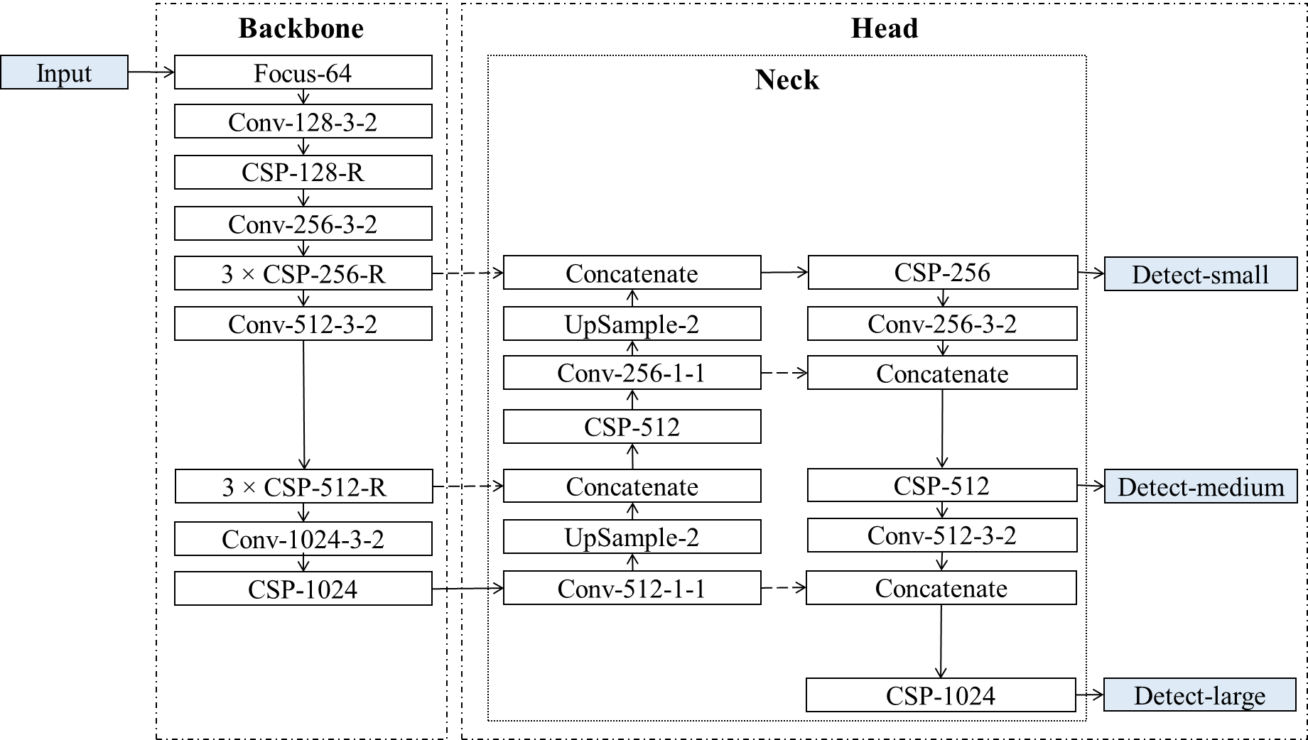
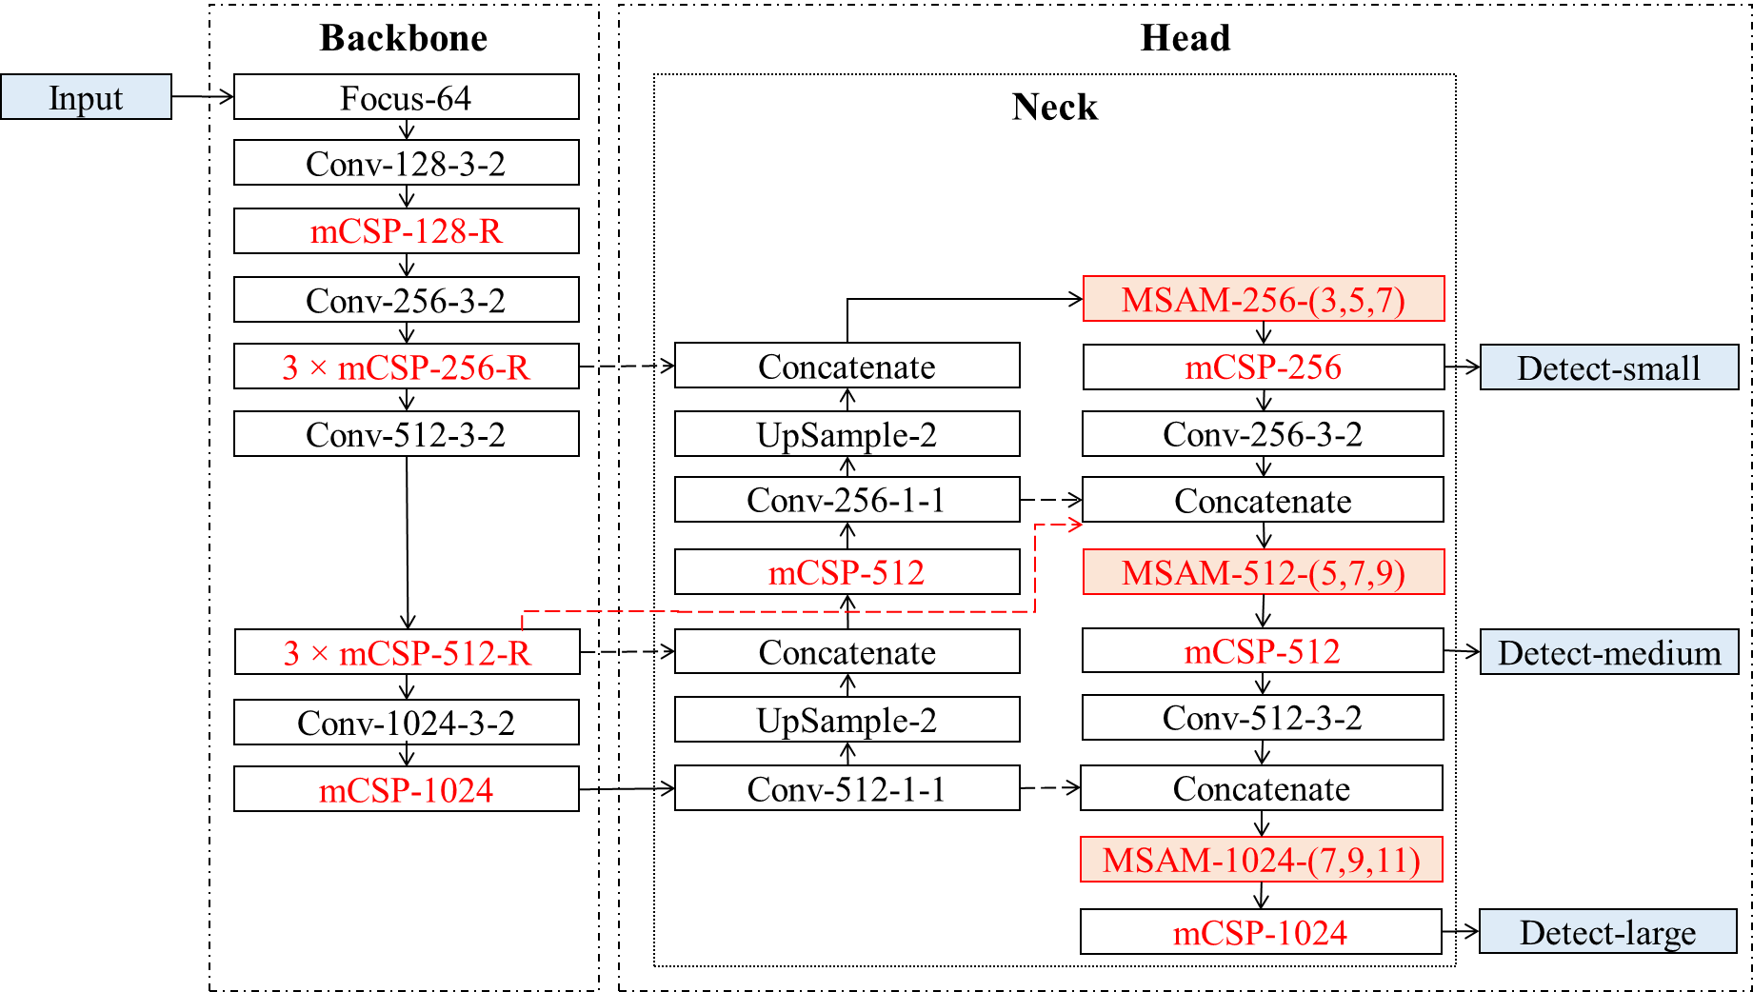
Ablation Studies on DhakaAI Dataset
It confirms the effectiveness of mCSP, mPANet, and MSAM modules to increase the accuracy of DhakaNet
α: DhakaNet-baseline
Final: DhakaNet
Notes:
To analyze the effectiveness of our proposed modules of DhakaNet, we conduct an ablation study of DhakaNet over DhakaAI dataset. For this purpose, we remove all the innovative changes from DhakaNet and consider this version as the baseline model. In every stage, we evaluate the object detection accuracy and corresponding inference speed, which is presented in the table. Here, every row represents the results for each variant of DhakaNet. From this table, DhakaNet having all the three modifications achieves the highest accuracy among all the other variants. Note that, the speed is getting dropped because of adding new modules to DhakaNet architecture. Next, we will see the efficacy of our MSAM module.

