Slide 1
Long-Range Low-Cost Networking for Real-Time Monitoring of Rail Tracks in Developing Countries
Saiful Islam Salim, Uday Kamal, Adnan Quaium, Mainul Hossain Yaad, Masfiqur Rahaman, Nazmul Hasan Sakib, A. B. M. Alim Al Islam
Department of Computer Science and Engineering,
Bangladesh University of Engineering and Technology,
Dhaka, Bangladesh

Slide 2
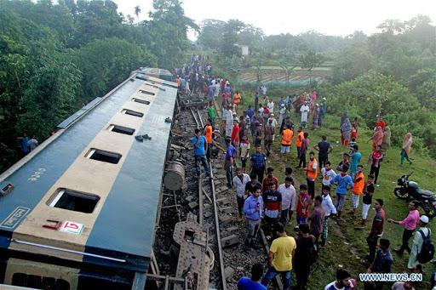
Derailment due to uprooted or faulty rail blocks is a major player for the railway accidents in developing countries such as Bangladesh, India, Pakistan, etc.
Notes:
Among all the accidents in rail line, 92% of the accidents occur due to derailments.
Such derailments result in both death tolls and loss of property.

Slide 3
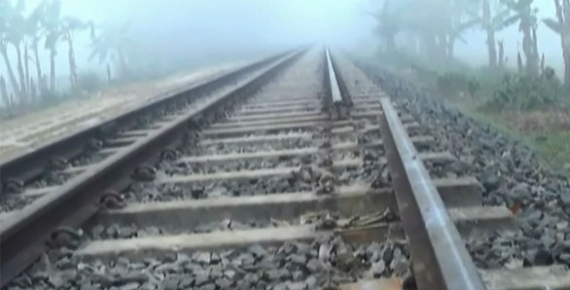
An automated system to prevent the accidents due to derailments through early detection of missing rails is necessary.
Challenges
Low-resource settings
Lack of networking infrastructure
Ensure enough response time for a driver to stop a running train

Slide 4
Because of the speed and momentum associated, ensuring enough response time to stop a running train is almost impossible just after the driver visually identifies a missing rail block.
Problem Definition
This work aims to provide a real-time pragmatic solution to inform an approaching train at a sufficiently long distance after detecting discontinuity in rail tracks.

Slide 5
We investigate different wireless networking paradigms to select a suitable mechanism for long-distance low-power communication to enable transmitting outcomes of the sensed data from rail tracks.
We devise a suitable methodology to set up low-cost wireless communication network over rail tracks for enabling real-time derailment detection.
Our Contributions
Our proposed model exhibits more than 99% packet delivery ratio by reducing the transmission data failure.

Slide 6
Railway Monitoring Systems
Motivation & Research Context
These systems are not effective in detecting missing rail blocks in real-time due to a proper communication network.
Most of the studies focus on detection of cracks, small breakages, stress, inclination, etc., in the rail tracks of the railway system.
P. Yilmazer et al. (2012),
A. Wilkinson (2013),
E. Berlin et al. (2013),
P. Kolakowski et al. (2011)
Several methods propose for monitoring the overall railway infrastructures.
E. Berlin et al. (2013),
F. Flammini et al. (2010),
A. Pascale et al. (2012),
V. Hodge et al. (2015)
Other studies investigate monitoring systems employing expensive machine vision systems.
Y. Dou et al. (2014),
Q. Li et al. (2018)

Slide 7
Networking over Rail Tracks
Motivation & Research Context (Cont.)
These solutions are not very suitable in the contexts of low-income, and limited-resource (i.e., developing) countries
A few studies focus on designing suitable network paradigm considering conditions of railway tracks and propose to use cellular systems, Bluetooth, IEEE 802.15.4, and WiFi for communication between the sensor nodes.
B. Ai et al. (2014),
V. J. Hod et al. (2015)
A. Pascal et al. (2012)
G. Shafiulla et al. (2013)

Slide 8
Specialized Solutions for Developing Countries
Motivation & Research Context (Cont.)
These solutions consider a networking distance of approximately 600m, which can be practically inadequate for stopping a train at a safe distance ahead of the fault.
A few studies on real-time solutions for detecting missing rail in the context of the developing countries.
T. Chakraborty et al. (2017),
T. Chakraborty et al. (2019),
N. Nurain et al. (2019)
These solutions did not consider the clearance for Fresnel zone.
These solutions overlooked the different diverse situations.

Slide 9
Our goal is to design a reliable low-cost long-range communication system for a railway sensor network.
Motivation & Research Context (Cont.)

Slide 10
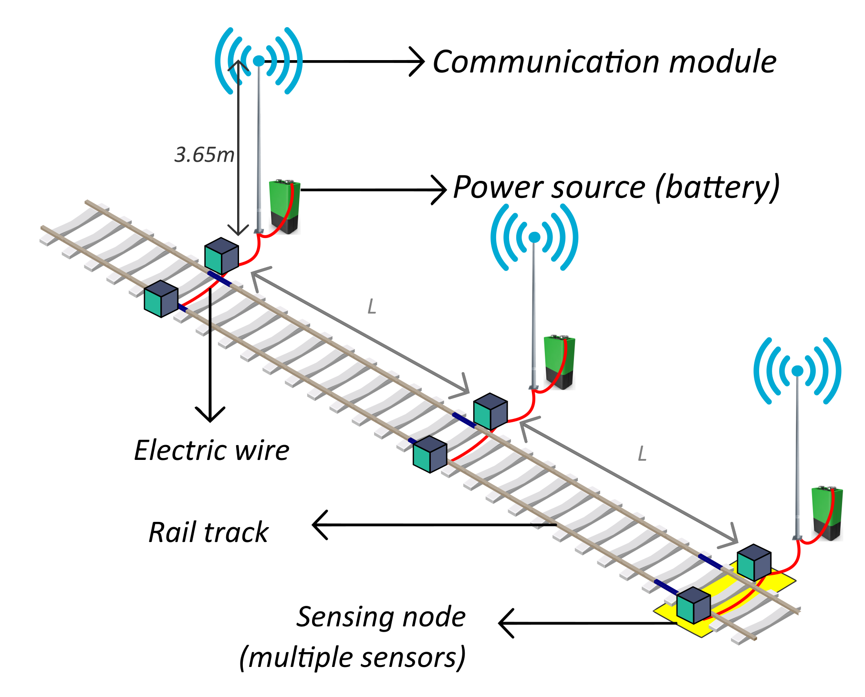
Simplified diagram of our proposed system
Proposed Methodology
Notes:
Sensors nodes on the rail track
a sensing unit (to sense the vibration in the rail)
a control unit (to analyze the vibration of the rail)
a communication module (to communicate with the inspector node)
Inspector node
a control unit (to analyze the data received from the sensor nodes on the rails)
a communication module (to communicate with the sensor nodes on the rails)

Slide 11
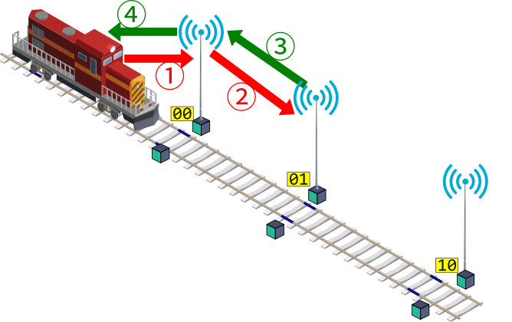
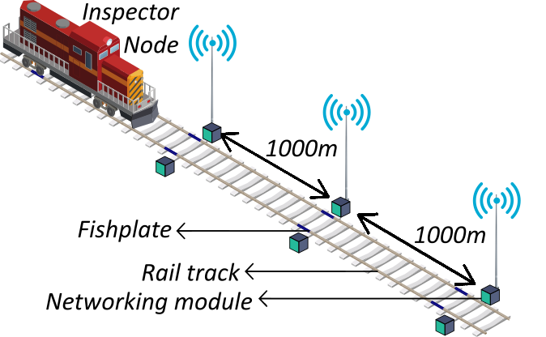
The proposed system mode
Proposed Methodology
Parent node
Child node
Notes:
Sensors nodes on the rail track
a sensing unit (to sense the vibration in the rail)
a control unit (to analyze the vibration of the rail)
a communication module (to communicate with the inspector node)
Inspector node
a control unit (to analyze the data received from the sensor nodes on the rails)
a communication module (to communicate with the sensor nodes on the rails)

Slide 12
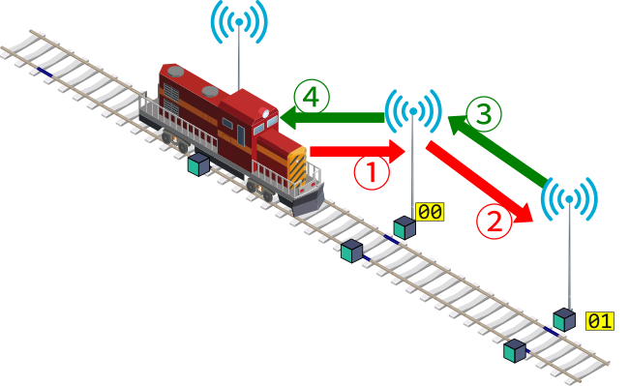
The proposed system mode
Proposed Methodology
Parent node
Child node
Notes:
Sensors nodes on the rail track
a sensing unit (to sense the vibration in the rail)
a control unit (to analyze the vibration of the rail)
a communication module (to communicate with the inspector node)
Inspector node
a control unit (to analyze the data received from the sensor nodes on the rails)
a communication module (to communicate with the sensor nodes on the rails)

Slide 13
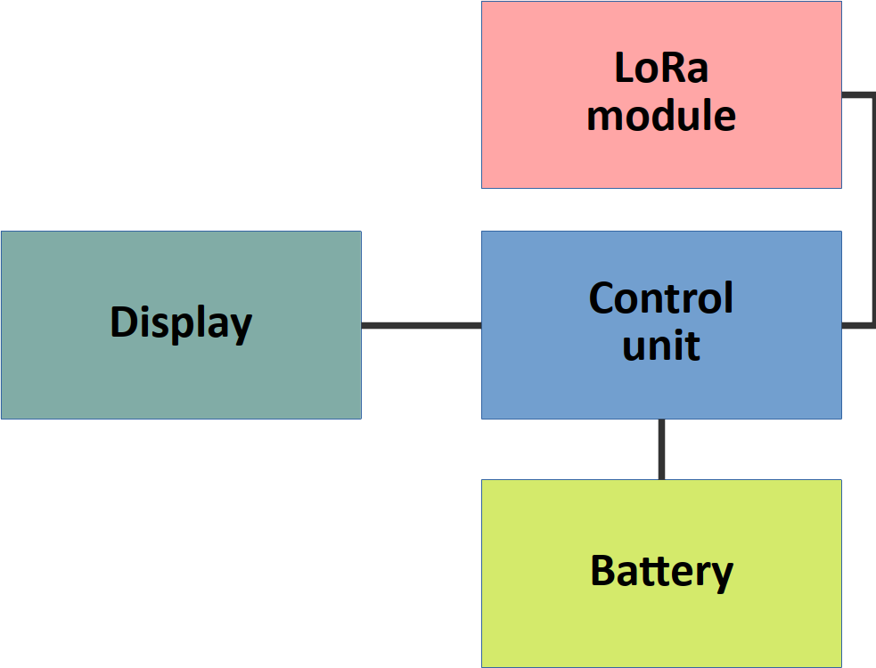
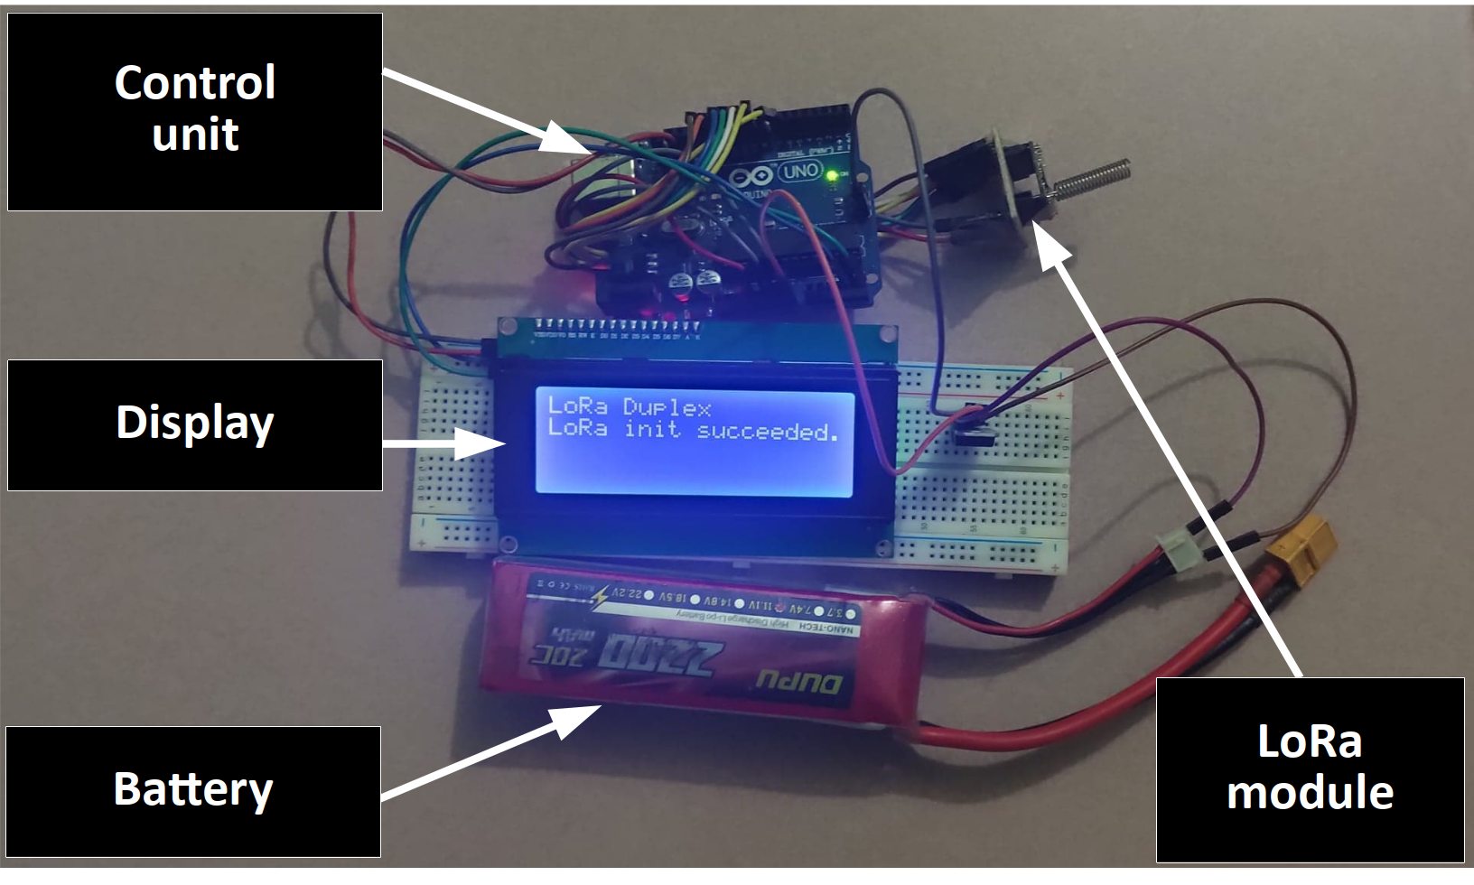
The Hardware
The Experiment
We utilize the Long Range networking module (LoRa RF-98) to achieve 1.5km to 2km long-range communication.
We mount a 2dBi spring antenna with the LoRa module.
We use ATmega328P as the micro-controller.
Fig: Block diagram of the module
Fig: The communication module

Slide 14
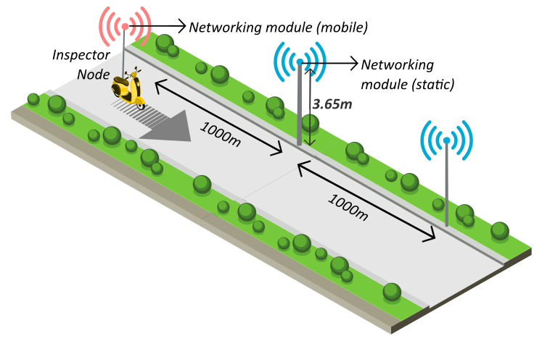
Experimental Setup
The Experiment (Cont.)

Slide 15
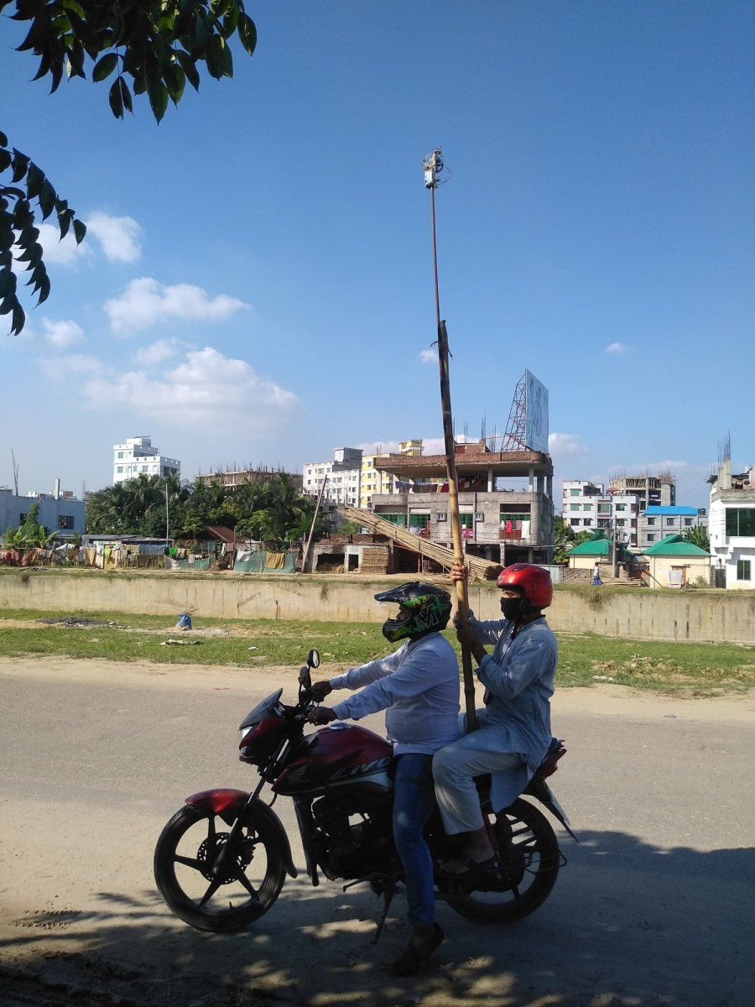
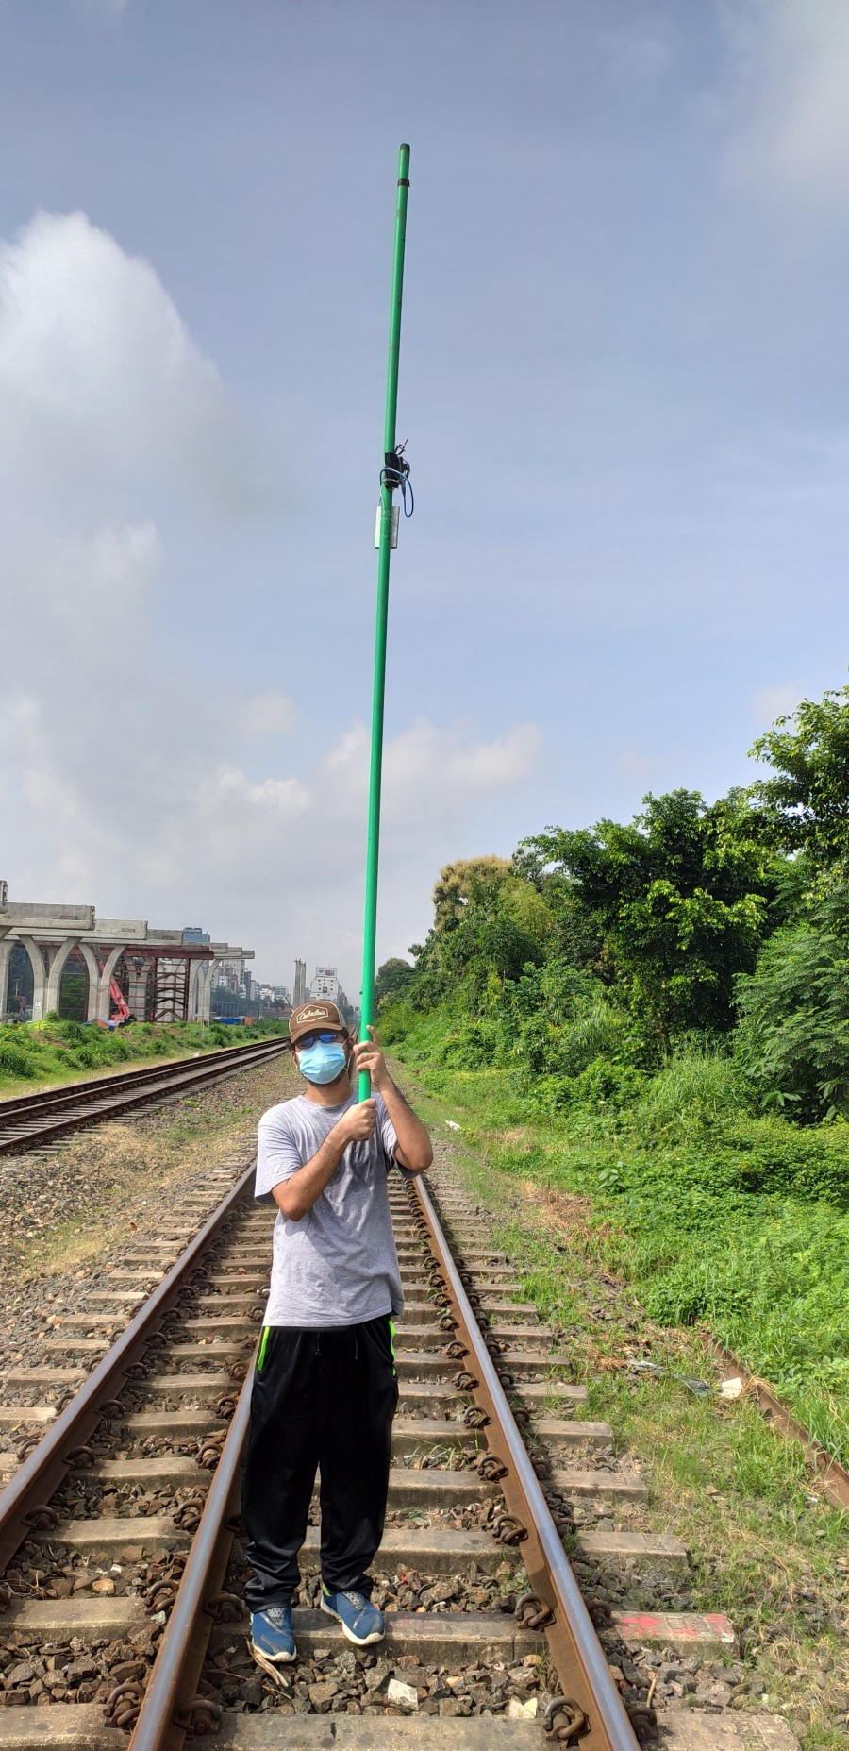
Experimental Setup
The Experiment (Cont.)

Slide 16
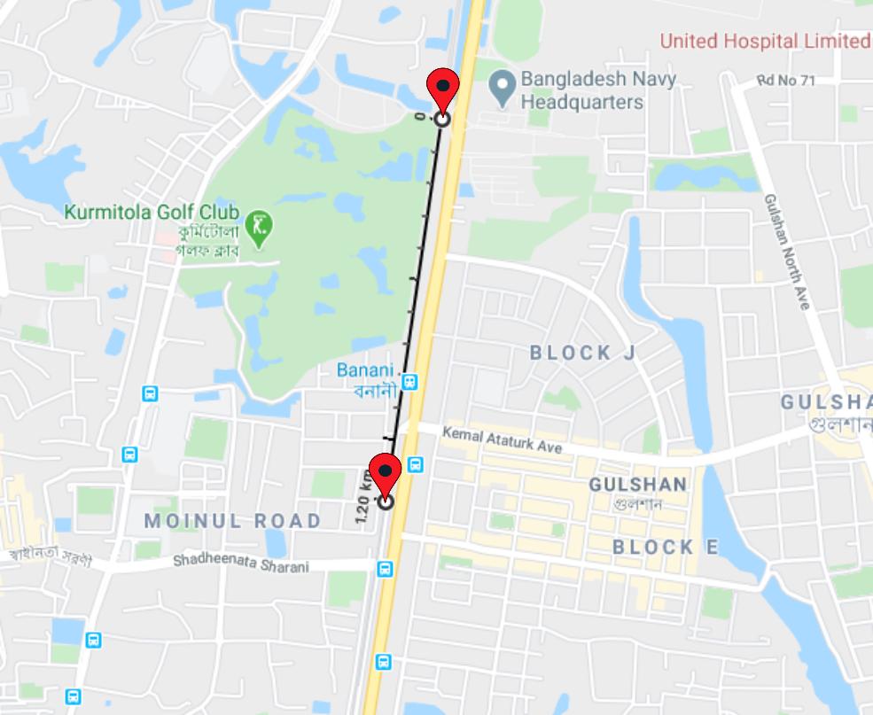
Static Single-hop Scenario
The Experiment (Cont.)
We maintain a distance of about 1200m between the two static LoRa nodes.
The experiment location is Banani Railway Station, Dhaka.
Notes:
The marked straight line indicates the rail tracks at the Banani railway station under experimentation.
The zone of experimenting is marked with two pins.
The distance between these two pins is 2000 m.

Slide 17
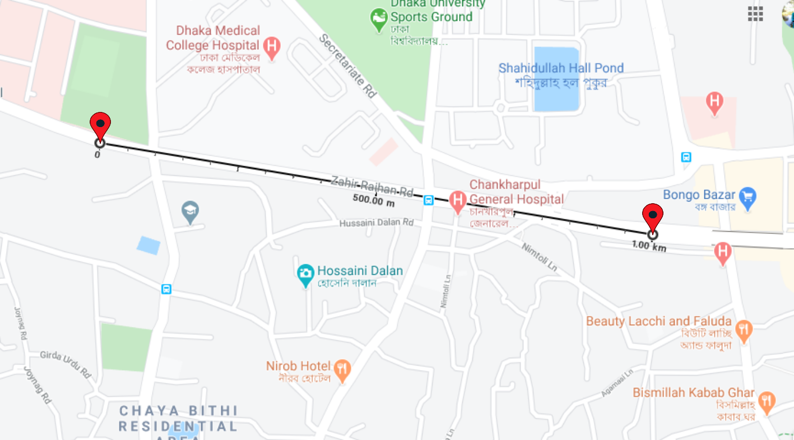
Mobile Single-hop Scenario
The Experiment (Cont.)
Only two nodes were considered.
The inspector node is mobile and the parent node is static.
The distance between the nodes is 1000m.
The experiment location is Zahir Raihan Road, Dhaka.
Notes:
The marked straight line indicates the rail tracks at the Banani railway station under experimentation.
The zone of experimenting is marked with two pins.
The distance between these two pins is 2000 m.

Slide 18
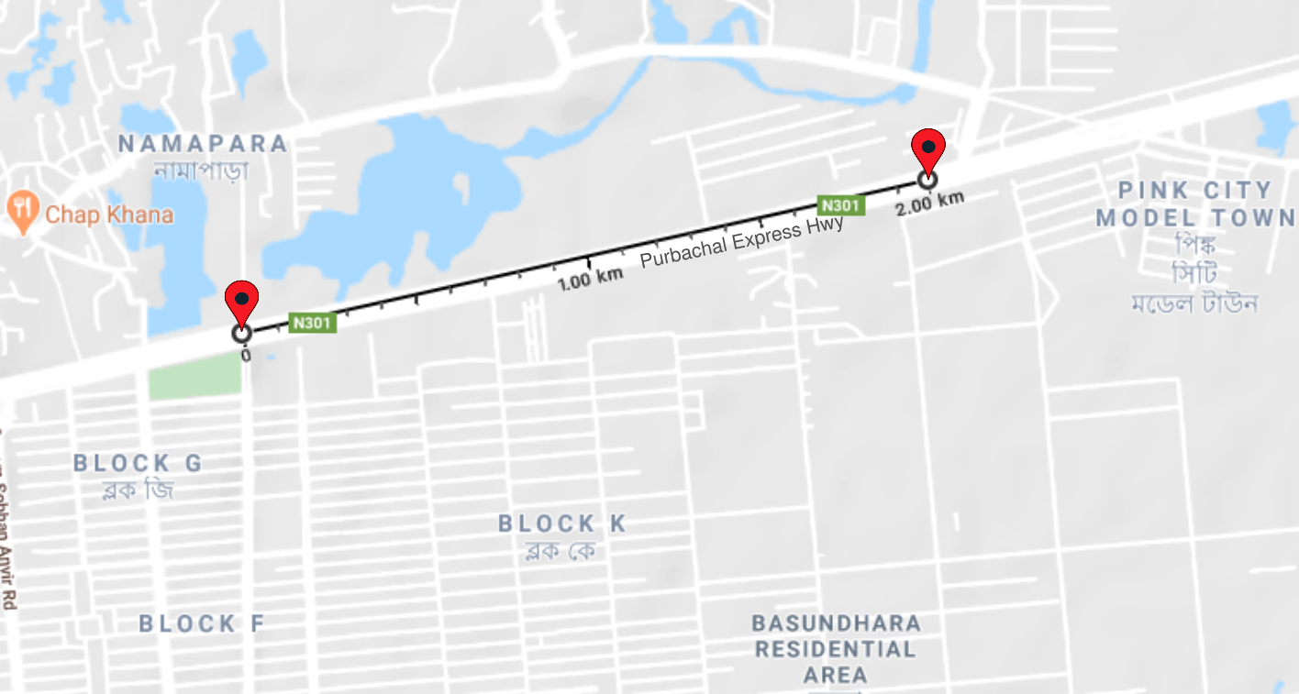
Mobile Multi-hop Scenario
The Experiment (Cont.)
Three nodes were considered.
One mobile inspector node, one static parent node, and one static child node.
The distance between the nodes is 1000m.
The experiment location is Purbachol Express Highway, Dhaka.
Notes:
The marked straight line indicates the rail tracks at the Banani railway station under experimentation.
The zone of experimenting is marked with two pins.
The distance between these two pins is 2000 m.

Slide 19
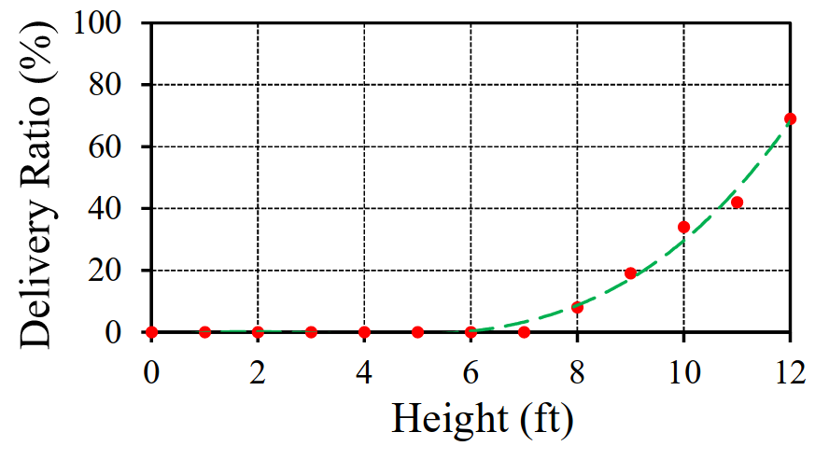
Static Single-hop Scenario
Analysis and Results

Slide 20
Static Multi-hop Scenario
Analysis and Results

Slide 21
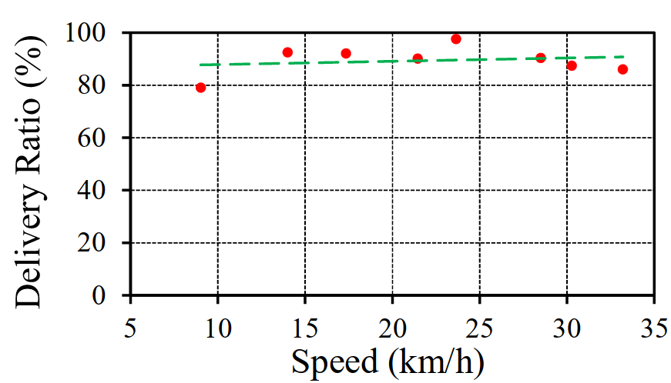
Mobile Single-hop Scenario
Analysis and Results

Slide 22
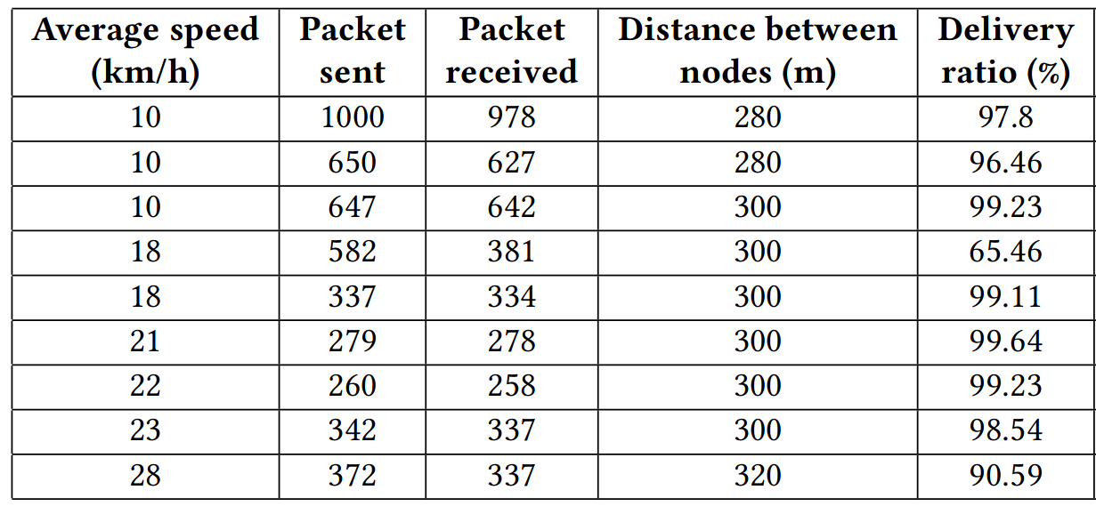
Mobile Single-hop Scenario
Analysis and Results

Slide 23
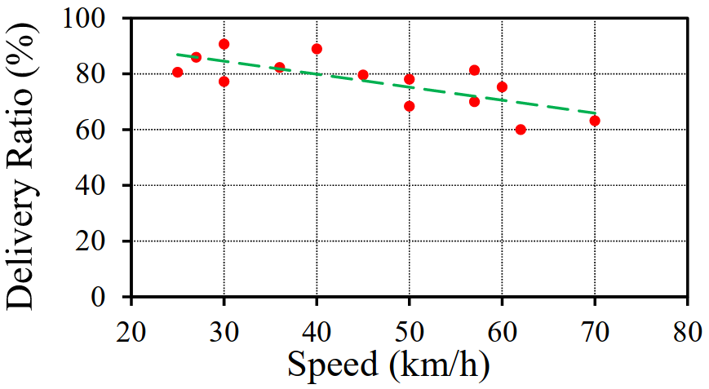
Mobile Multi-hop Scenario
Analysis and Results

Slide 24
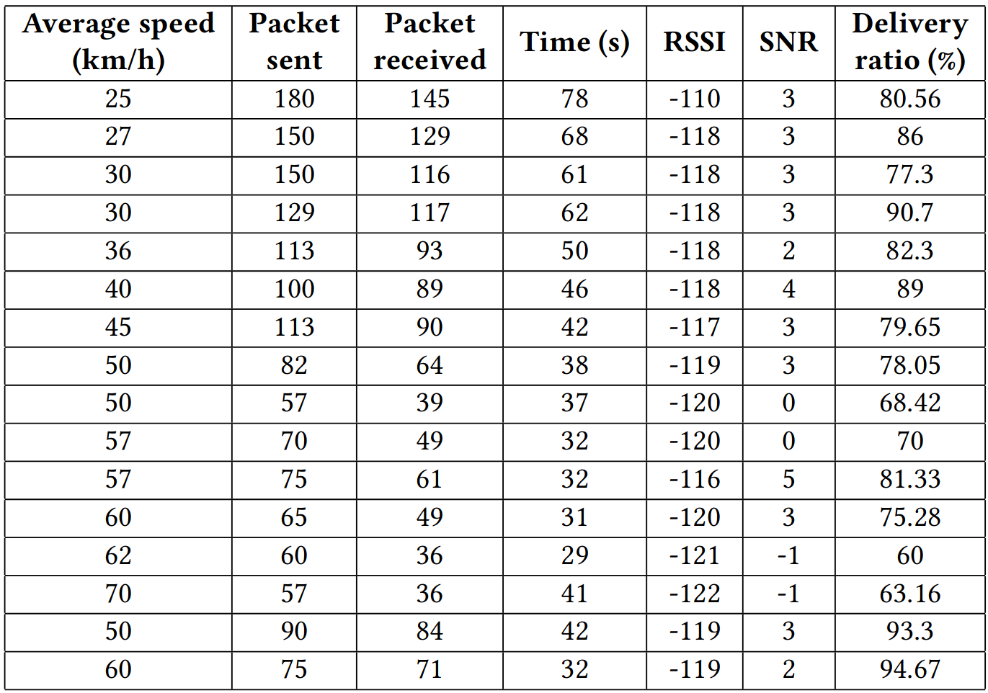
Mobile Multi-hop Scenario
Analysis and Results

Slide 25
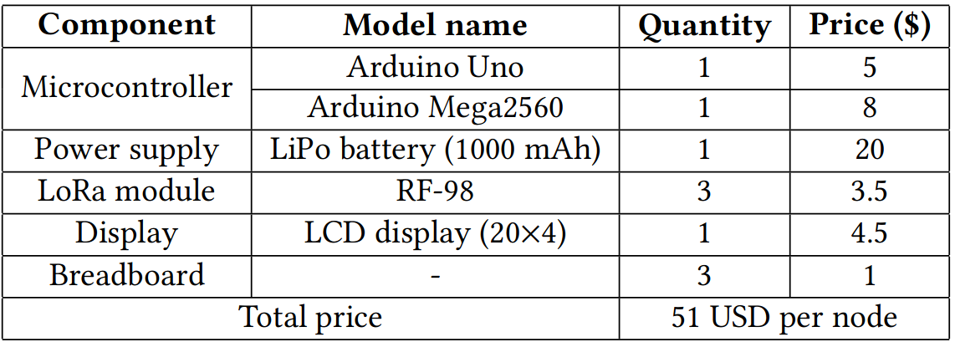
Cost Analysis
Notes:
This is the breakdown of the price for each sensor node. Our total cost for one unit is around 68 US dollar.

Slide 26
Conclusion
We rigorously collect a vast amount of real-time data by varying distances, speeds, and height of our developed networking module in the context of a developing country.
We propose a new wireless networking modality to achieve a long coverage of around 2000m over rail lines.
In the future, we plan to investigate other unexplored aspects that are needed for the intended complete solution.

Slide 27
References
P. Yilmazer, A. Amini, and M. Papaelias, “The Structural Health Condition Monitoring of Rail Steel using Acoustic Emission Techniques,” in Proc. 51st Annu. Conf. NDT, 2012, pp. 1–12.
A. Wilkinson, “Long Range Inspection and Condition Monitoring of Rails using Guided Waves,” in Proc. 12th Int. Conf. Exhib., Railway Eng., London, UK, 2013.
E. Berlin and K. Van Laerhoven, “Sensor Networks for Railway Monitoring: Detecting Trains from Their Distributed Vibration Footprints,” in Distributed Computing in Sensor Systems (DCOSS), 2013 IEEE International Conference on. IEEE, 2013, pp. 80–87.
P. Kolakowski, J. Szelkazek, K. Sekula, A. Swiercz, K. Mizerski, and P. Gutkiewicz, “Structural Health Monitoring of a Railway Truss Bridge Using Vibration-Based and Ultrasonic Methods,” Smart Materials and Structures, vol. 20, no. 3, p. 035016, Feb 2011.
F. Flammini, A. Gaglione, F. Ottello, A. Pappalardo, C. Pragliola, and A. Tedesco, “Towards Wireless Sensor Networks for Railway Infrastructure Monitoring,” 11 2010, pp. 1 – 6.
A. Pascale, N. Varanese, G. Maier, and U. Spagnolini, “A Wireless Sensor Network Architecture for Railway Signaling,” in Proceedings of the 9th Italian netw. workshop., 04 2012, pp. 1–4.
V. Hodge, S. O’Keefe, M. Weeks, and A. Moulds, “Wireless Sensor Networks for Condition Monitoring in the Railway Industry: a Survey,” IEEE Transactions on Intelligent Transportation Systems, vol. 16, no. 3, pp. 1088–1106, 6 2015.
Y. Dou, Y. Huang, Q. Li, and S. Luo, “A Fast Template Matching Based Algorithm for Railway Bolts Detection,” International Journal of Machine Learning and Cybernetics, vol. 5, no. 6, pp. 835–844, 2014.

Slide 28
References (Cont.)
Q. Li, Z. Shi, H. Zhang, Y. Tan, S. Ren, P. Dai, and W. Li, “A Cyber-Enabled Visual Inspection System for Rail Corrugation,” Future Generation Computer Systems, vol. 79, pp. 374 – 382, 2018.
S. Das, P. Saha, and S. Patro, “Vibration-Based Damage Detection Techniques Used for Health Monitoring of Structures: a Review,” J Civil Struct Health Monit, vol. 6, p. 477–507, 2016.
A. B. Noel, A. Abdaoui, T. Elfouly, M. H. Ahmed, A. Badawy, and M. S. Shehata, “Structural Health Monitoring Using Wireless Sensor Networks: A Comprehensive Survey,” IEEE Communications Surveys Tutorials, vol. 19, no. 3, pp. 1403–1423, 2017.
E. Peek and W. Basta, “Broken Rail Detection System and Method,” 08 2000, uS Patent 6,102,340.
T. Chakraborty, T. A. Khan, and A. Islam, “Poster: RailCop: Detecting Missing Rail on Railway Using Wireless Sensor Networks,” in Proceedings of the 14th Annual International Conference on Mobile Systems, Applications, and Services Companion. ACM, 2016, pp. 16–16.
T. Chakraborty, N. Nurain, S. Tairin, T. A. Khan, J. Noor, M. R. Islam, and A. A. Al Islam, “A New Network Paradigm for Low-Cost and Lightweight Real-Time Communication between Train and Rail Track to Detect Missing and Faulty Rail Blocks,” Journal of Network and Computer Applications, vol. 131, pp. 40 – 54, 2019.
N. Nurain, S. Tairin, T. A. Khan, S. Ishraq, and A. A. Al Islam, “Power Attack: An Imminent Security Threat in Real-Time System for Detecting Missing Rail Blocks in Developing Countries,” Computers & Security, vol. 84, pp. 35 – 52, 2019.

Slide 29
Thank you

